Slide 1
WHAT IS IT & HOW DOES IT WORK?

Slide 2
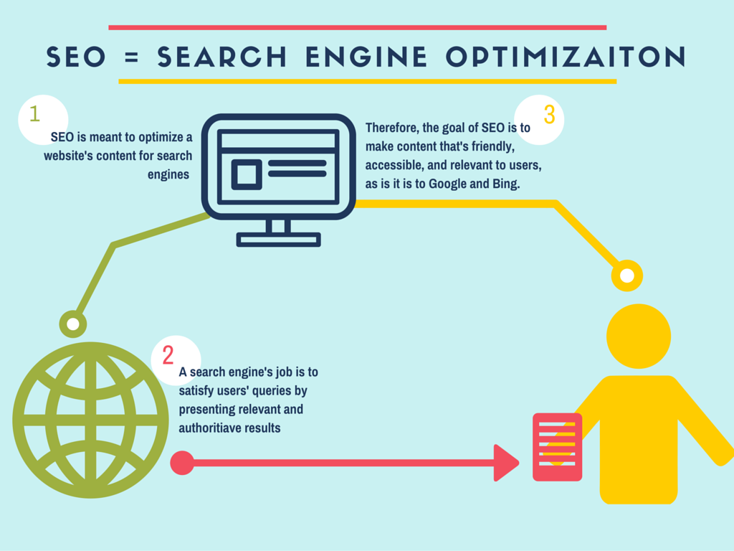
SEO = SEARCH ENGINE OPTIMIZATION
SEO = search engine optimization
optimizing content for search engines, right?
Therefor if a search engine's jobs is to satisfy users' queries, then the goal of SEO is to make content that's friendly, accessible, and relevant to users, as is it is to Google and Bing.
If you're responsible for a website, SEO is a cornerstone!
But wait, there is so much more! SEO is not a silo
Homework: Check to see if all your pages are being ranked by searching site:www.website.com

Slide 3
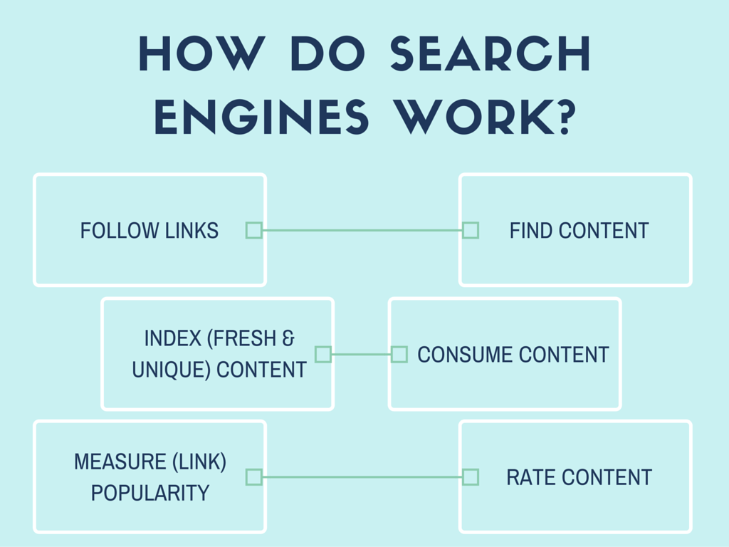

Slide 4
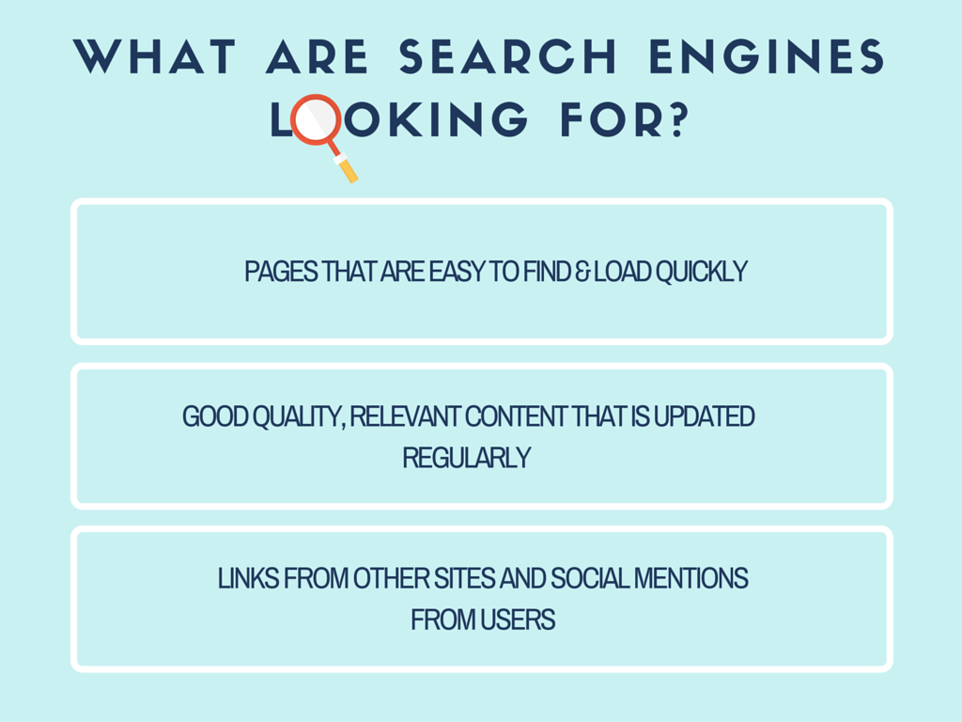
Homework: Check you site speed and performance insights @ http://tools.pingdom.com/fpt/

Slide 5
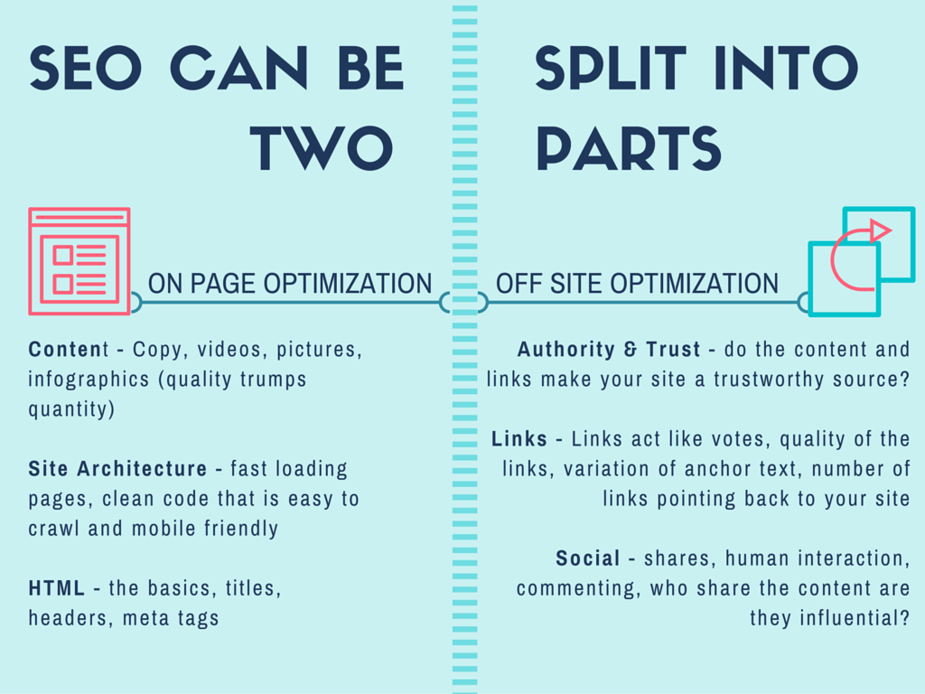
Homework: Set up Google Webmaster Tools/Search Console: http://www.bruceclay.com/newsletter/volume117/set-up-google-webmaster-tools.htm

Slide 6
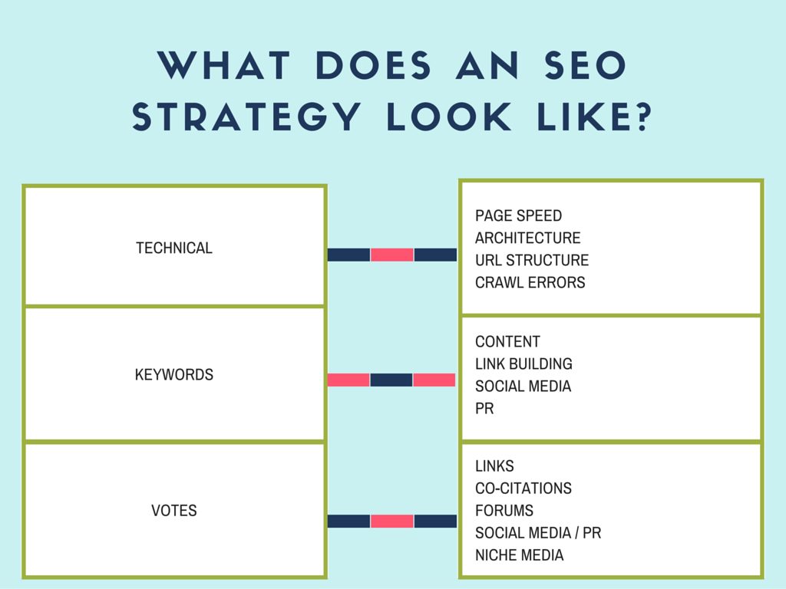
Homework: Do your own website audit: http://www.towermarketing.net/seo-audit-checklist-small-businesses-guide-understanding-health-website/

Slide 7
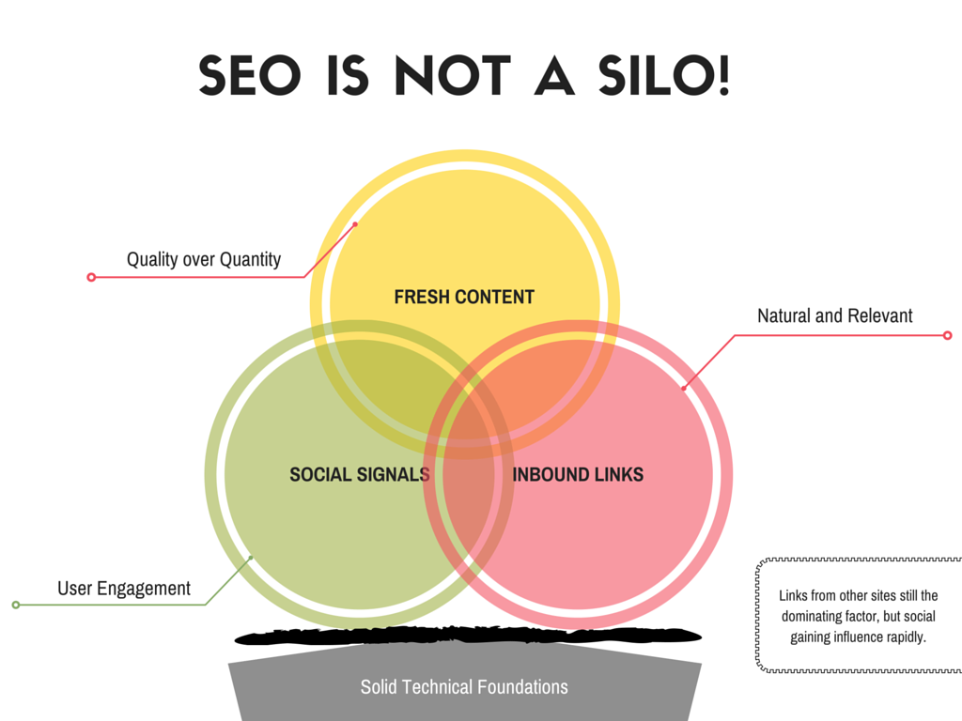
Homework: Check how many backlinks you have on your site: https://moz.com/researchtools/ose/

Slide 8
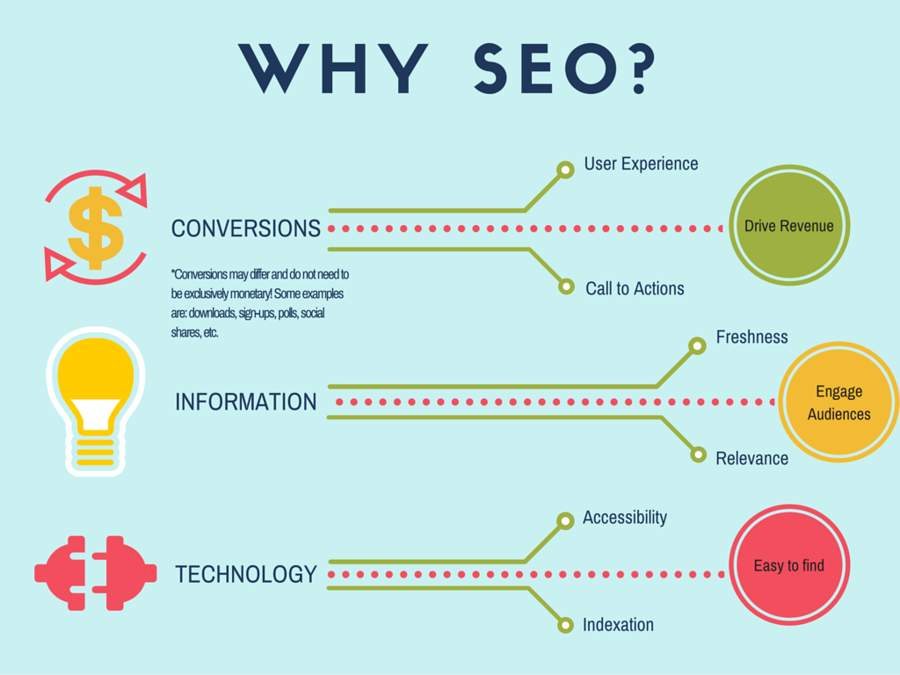

Slide 9
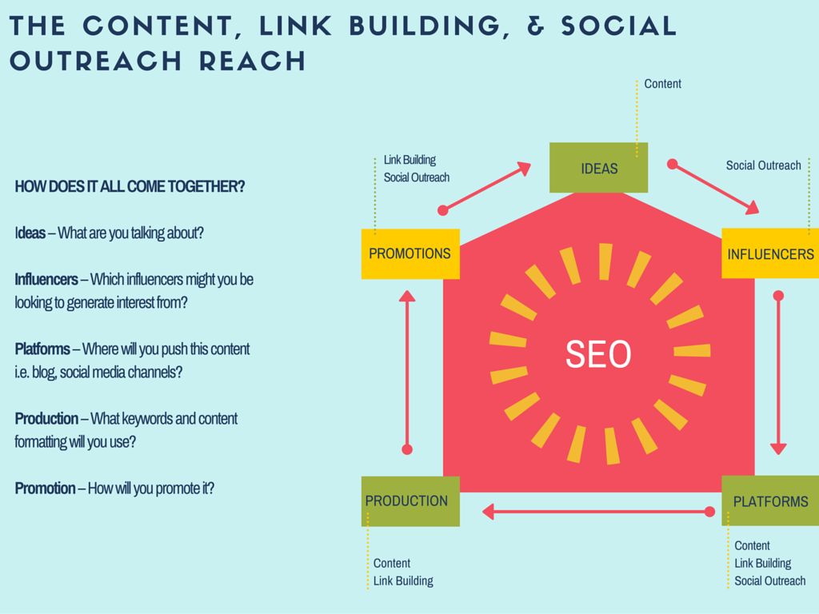

Slide 12
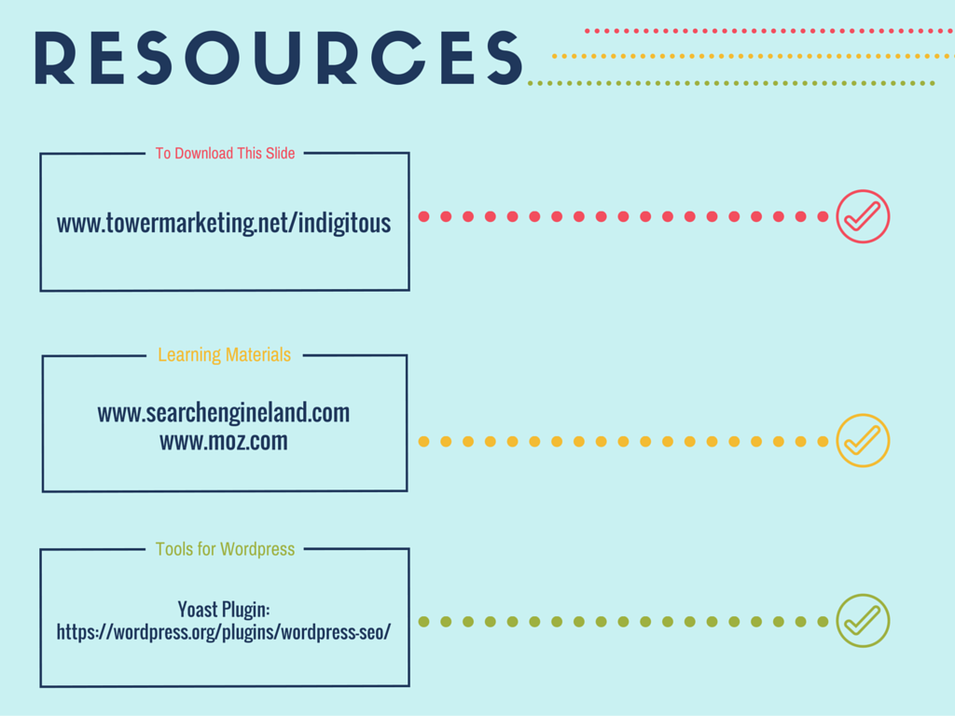

Slide 13
Thanks for downloading
www.towermarketing.net

